Slide 1
















operating system
11:11PM

Slide 2


Team Members
Antonious Emad Kamel
Abanoub shafeeq Zakhier
Demyana Sharl Shaker
Tony Mikhaiel
Paula Ayman
Back to Agenda Page

Slide 3
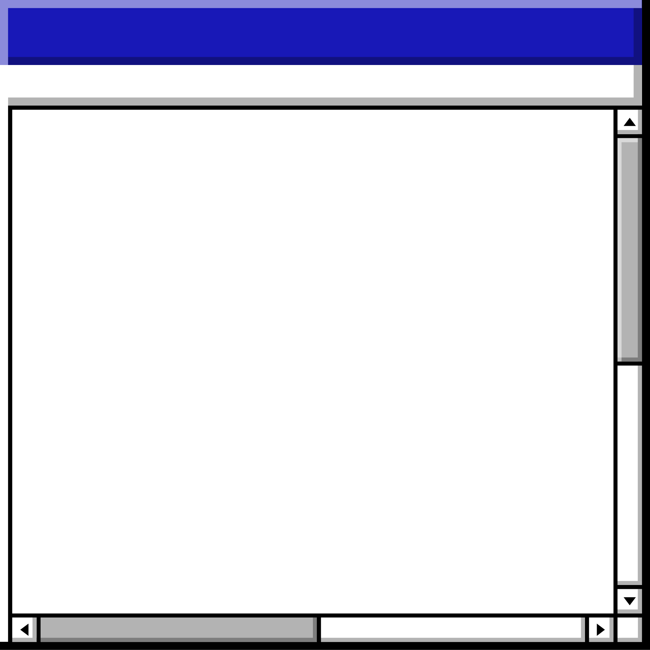

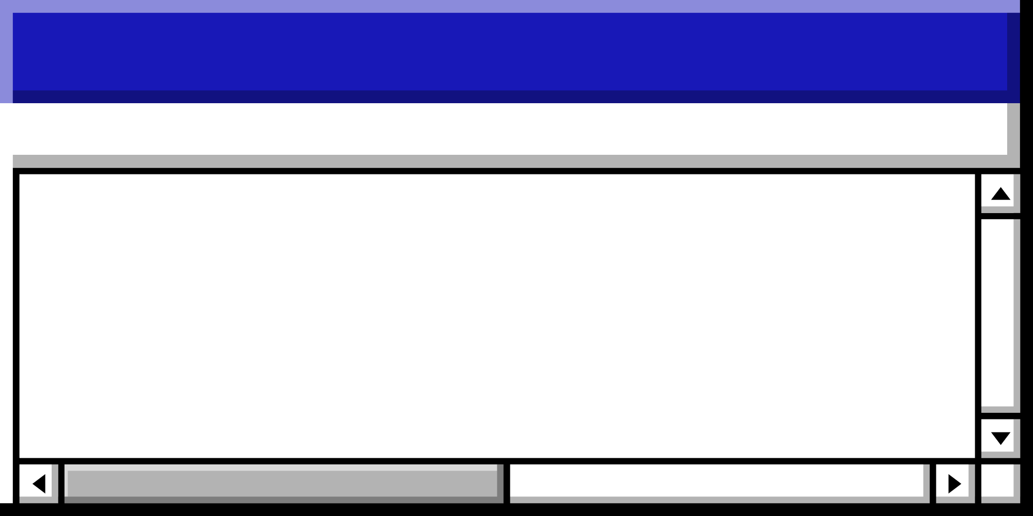
Agenda • Agenda • Agenda • Agenda • Agenda • Agenda • Agenda • Agenda • Agenda • Agenda • Agenda • Agenda • Agenda • Agenda
Tip: Use links to go to a different page inside your presentation.
How: Highlight text, click on the link symbol on the toolbar, and select the page in your presentation you want to connect.
Topics Covered
Code Structure
Scheduling Algorithms
Agenda
Performance Analysis
conclusion

Slide 4















Section Header • Section Header • Section Header • Section Header • Section Header • Section Header • Section Header • Section Header
Code Structure
Back to Agenda Page
Section Header • Section Header • Section Header • Section Header • Section Header • Section Header • Section Header • Section Header

Slide 5
Section Header • Section Header • Section Header • Section Header • Section Header • Section Header • Section Header • Section Header
Scheduling Algorithms
Back to Agenda Page
Section Header • Section Header • Section Header • Section Header • Section Header • Section Header • Section Header • Section Header

Slide 6
Section Header • Section Header • Section Header • Section Header • Section Header • Section Header • Section Header • Section Header
Performance Analysis
Back to Agenda Page
Section Header • Section Header • Section Header • Section Header • Section Header • Section Header • Section Header • Section Header

Slide 7

FCFS | SJF | RR | STF | Stride | MLFQ
high waiting time, especially for long jobs | low waiting time for short jobs but can lead to starvation for long jobs | fair waiting time | similar to SJF | equal waiting time for all processes | Higher priority lower waiting time, but lower priority higher waiting time.
higher turnaround | low turnaround | Shorter time slices higher turnaround time due to frequent context switching | lower turnaround time | balanced turnaround time | optimizes turnaround time by assigning higher priority to shorter jobs
slow response time, especially for long jobs | fast response time for short jobs as they are executed first. | Shorter time slices faster response time due to frequent context switching | fast response time | balanced response time for all processes, | new processes faster response time
relatively low context switching overhead | low context switching overhead as it executes processes until completion | higher context switching overhead due to frequent time slice expiration and process switching | low context switching overhead as it executes the process with the shortest remaining time. | moderate context switching overhead, as it uses proportional share scheduling | moderate context switching overhead due to the process priority adjustments and queue transitions.
Waiting time
Turnaround time
Response time
Context switching overhead

Slide 8
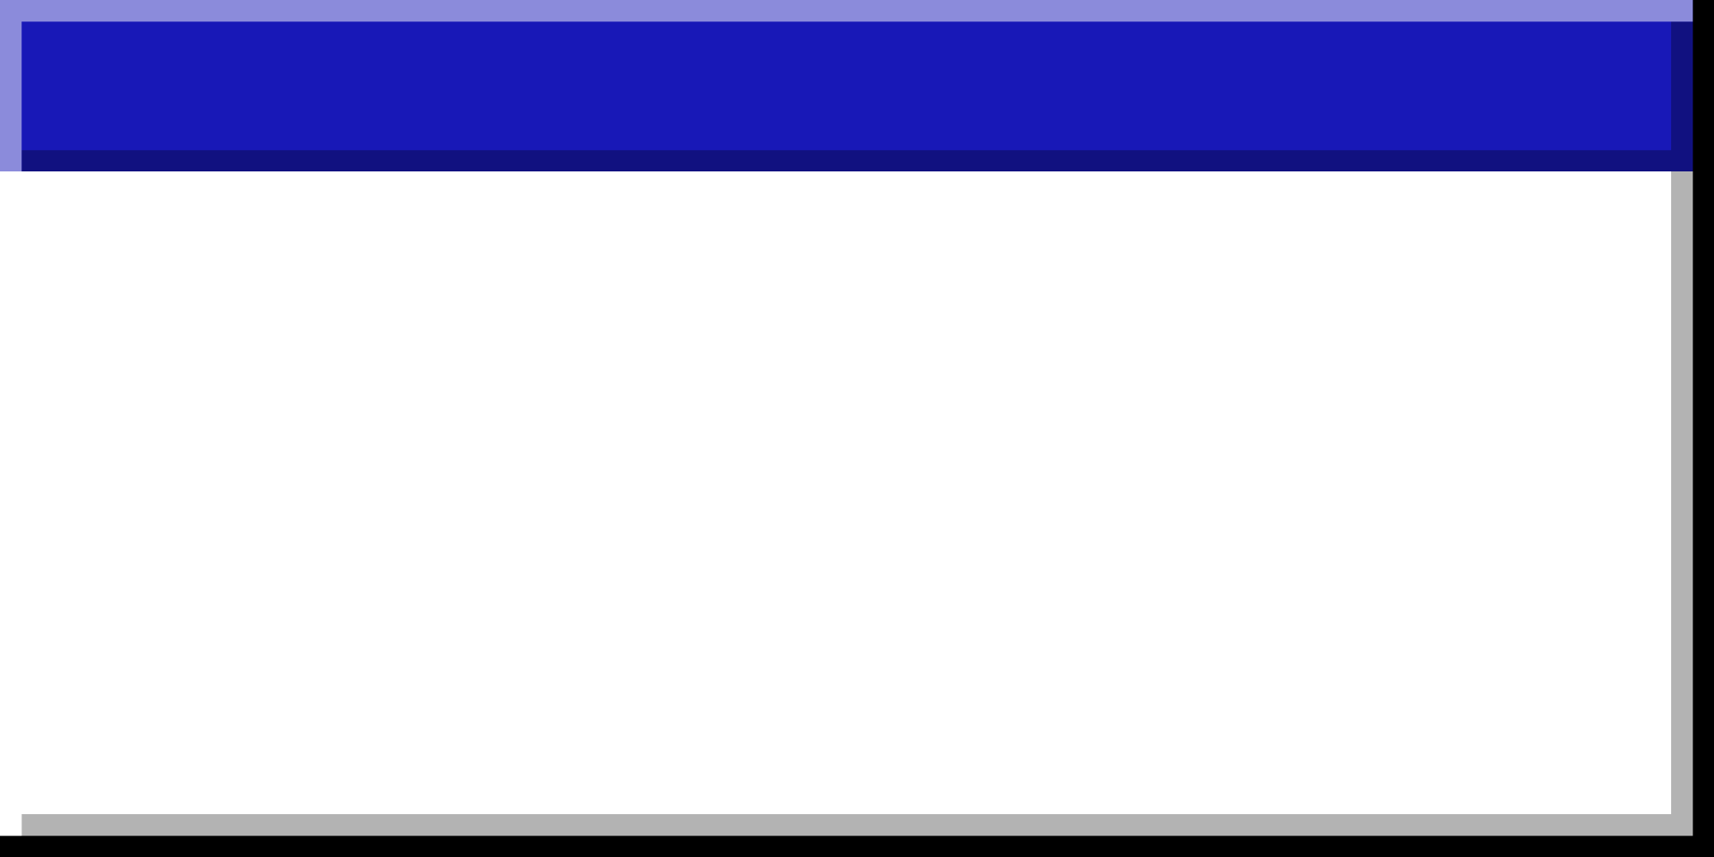
key takeaways:
SJF and STF often have the lowest waiting and turnaround times, but can suffer from high response times for longer jobs.
FCFS is simple and fair, but can result in high waiting times for short jobs behind long ones.
RR provides predictable response times and prevents starvation, but its performance depends on the time quantum.
STRIDE prioritizes interactive processes and provides good response times, but can introduce overhead for managing priorities.
MLFQ balances short and long job performance, but can have overhead due to level switching.

Slide 9
Section Header • Section Header • Section Header • Section Header • Section Header • Section Header • Section Header • Section Header
conclusion
Back to Agenda Page
Section Header • Section Header • Section Header • Section Header • Section Header • Section Header • Section Header • Section Header

Slide 10
Finally
Multi-core scheduling is vital for system efficiency.
Understanding different algorithms helps optimize performance.
Each algorithm has unique characteristics and use cases.
Back to Agenda Page

Slide 11

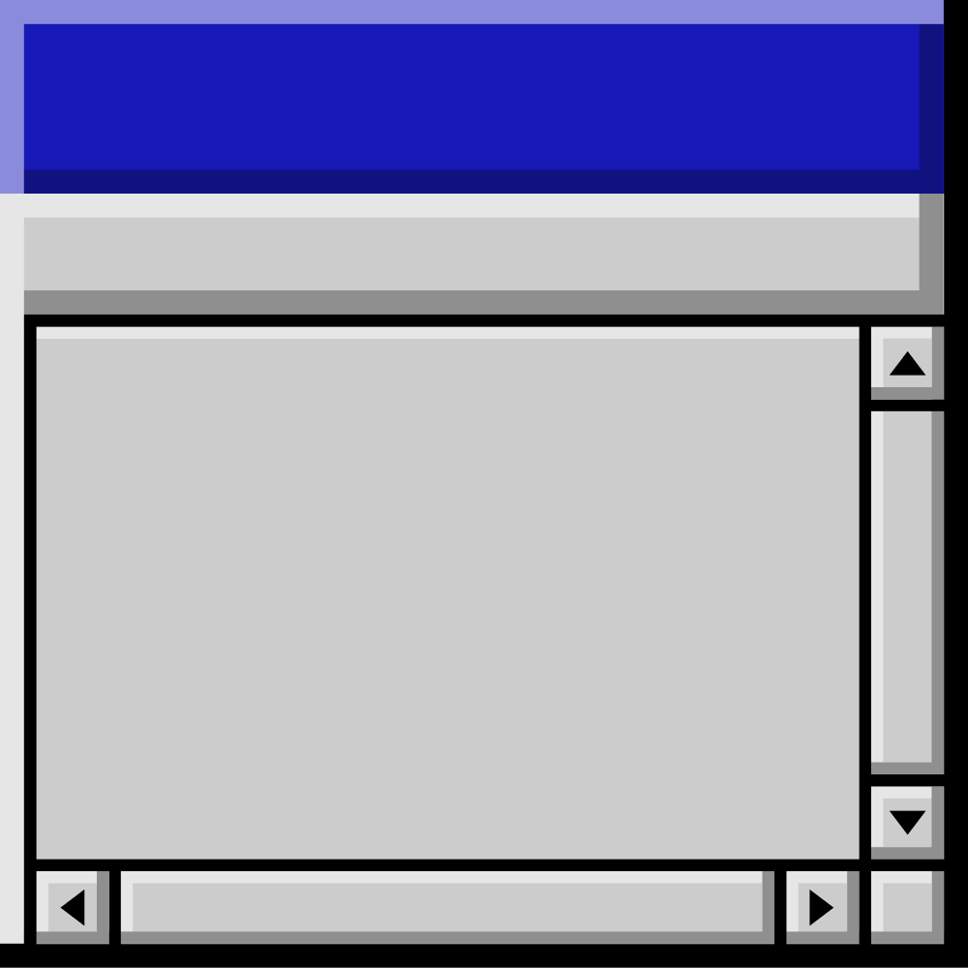
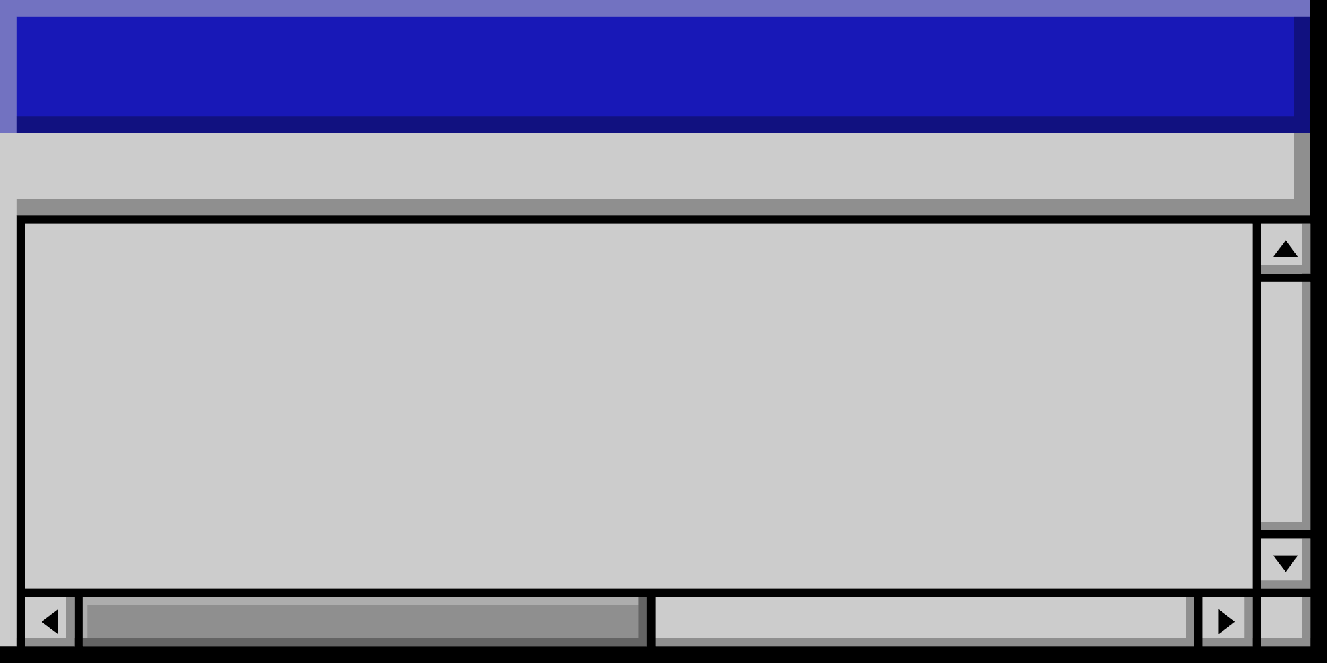
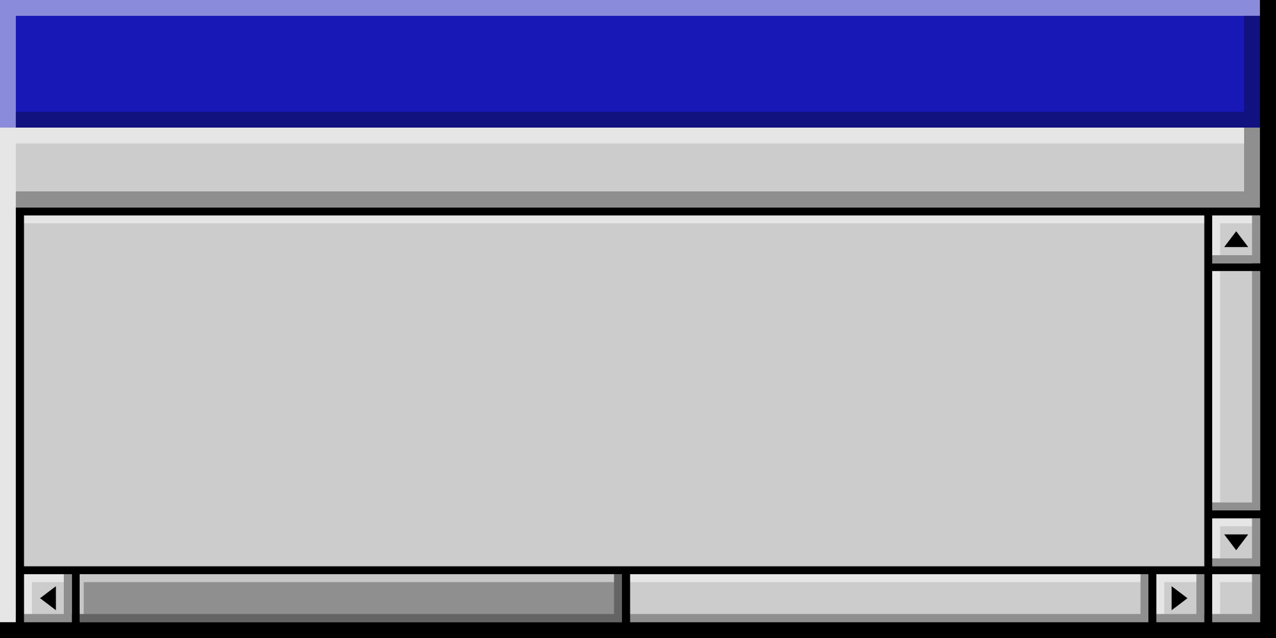

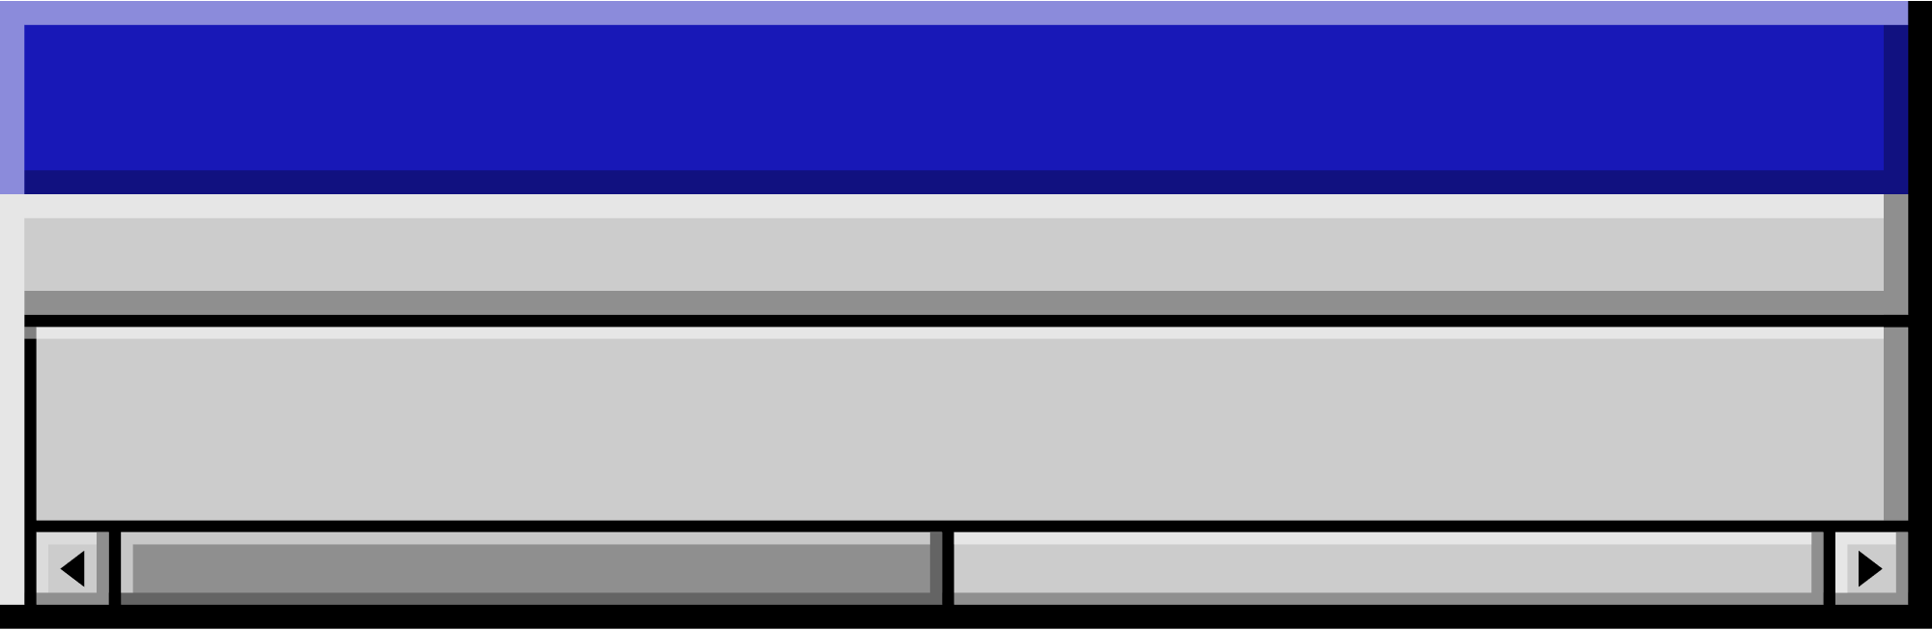
Thank you!
Insert a parting or call-to-action message here.

Slide 12
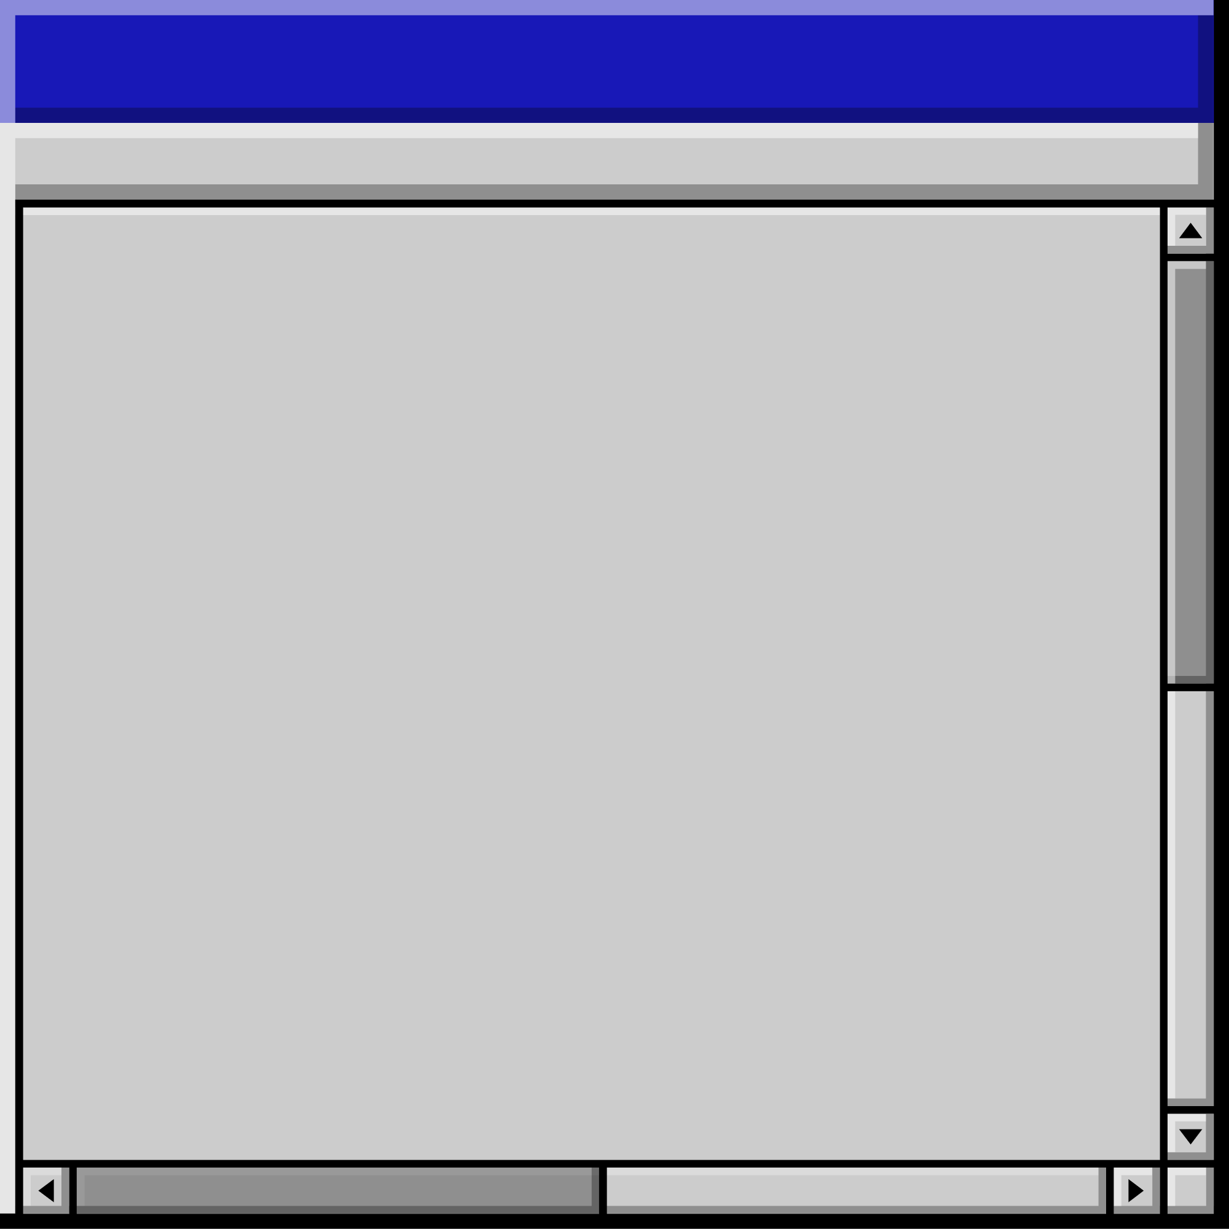


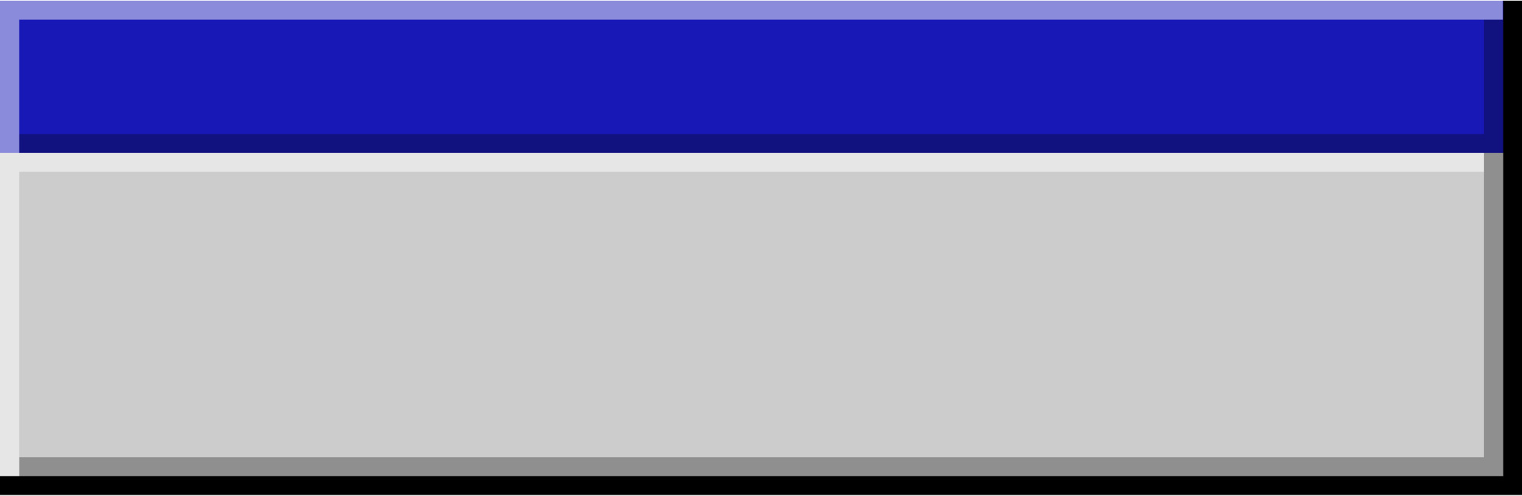

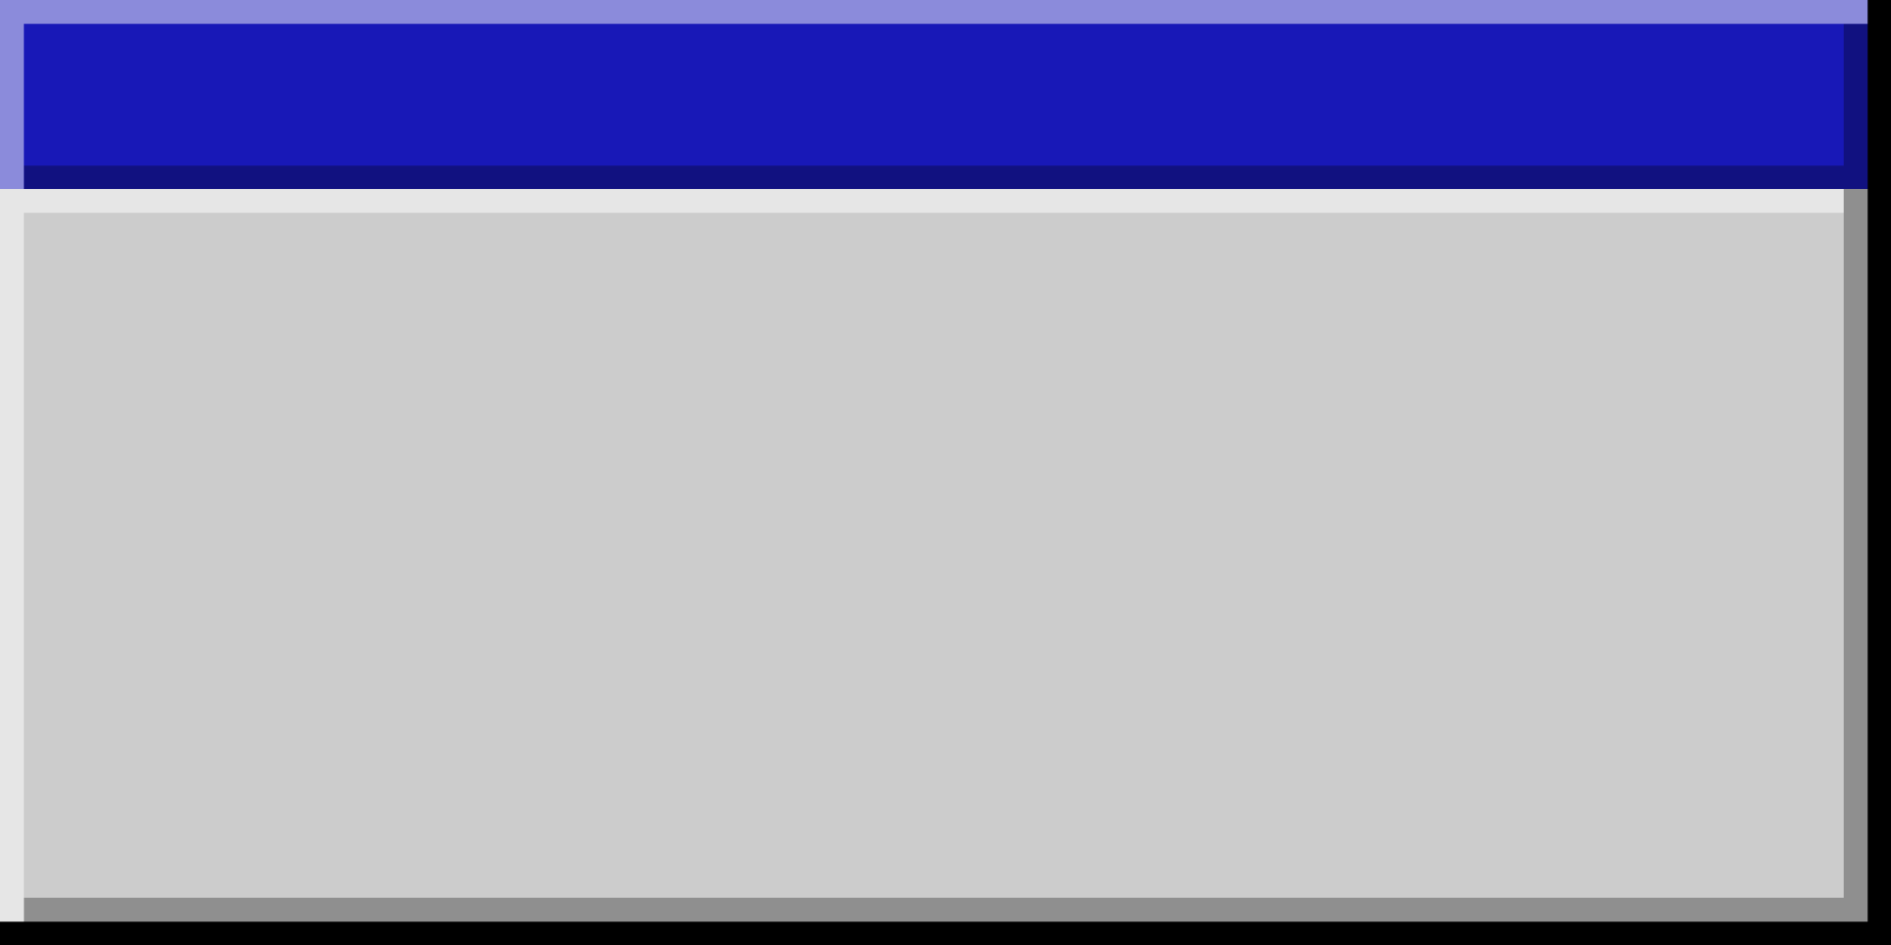



Resource
Page
Use these design resources
in your Canva Presentation.
Happy designing!
Don't forget to delete
this page before presenting.

